Slide 1
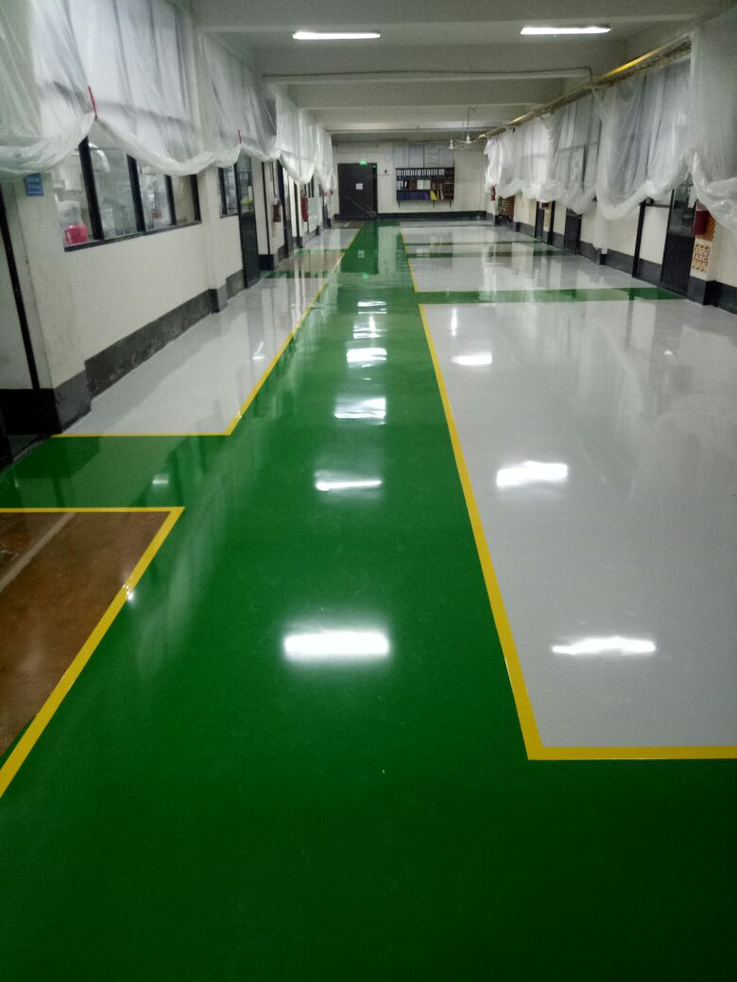
Effective flooring solution –
ELANTAS Beck India Ltd.

Slide 2
Epoxy Flooring Application
11/07/26
Page <number>
ELANTAS Beck India Ltd.
Contents
Scope of Work
Beck Bond SLF 36 System for flooring area
System Proposal
Sequence of Application

Slide 3
11/07/26
Page <number>
ELANTAS Beck India Ltd.
Site condition address by effective flooring solution :-
Treatment of Joints
Treatment of floor
Surface having very high & different range of undulation
The leveling at various place is not in range.
Filling of pot holes if any
Aesthetic look

Slide 4
11/07/26
Page <number>
ELANTAS Beck India Ltd.
Scope of work
Application of suitable flooring system which can suffices need as :-
Cover the undulation
Have excellent durable Aesthetical finished floor system
Easily cleanable
No water seepage inside
Repairable.
Less or no scratch mark.

Slide 5
11/07/26
Page <number>
ELANTAS Beck India Ltd.
Beck Bond SLF 36 system
Beck Bond SLF 36 system is High gloss, High mechanical property epoxy based system for floor toping ( flooring system ) application:-
Smooth finish
Excellent adhesion to concrete
Solvent free
Good chemical and abrasion resistance
Easy to clean
Does not support bacterial growth
It comes in following variety :-
Beck Bond SLF 36 - Self leveling Epoxy flooring system.
Beck Bond SLF 36 CS - Self leveling granite finish epoxy
Beck Bond SLF 36 + PU 90 – Self leveling epoxy with Matt coat.

Slide 6
11/07/26
Page <number>
ELANTAS Beck India Ltd.
Surface Preparation: -
a. Clean the surface thoroughly by mechanical means preferably using mechanical grinders/vacuum assisted shot blasting machine or scarified to remove loose particles, dust, dirt, laitance, etc. The area cleaned thoroughly. Concrete floor should be at least 28 days old or have a moisture content of less than 5% before proceeding with epoxy application.
b. For metal surfaces remove out all rust by acid wash methods. Further clean with mild soap solution and rinse with water.
Treatment of Construction joint :-
Joint Treatment:
Open the concrete panel joints and clean them thoroughly. Mix Epoxy resin Dobeckot 5022 and Hardener EH 460 in the given proportion (100:100) along with filler and pour the mixture in the cleaned joint. Appropriate joint treatment depending on site conditions shall be selected.
OR
Open the concrete panel joints and clean them thoroughly
Application of pour grade Polysulphide sealant up to depth of 1 inch of width 5 -6

Slide 7
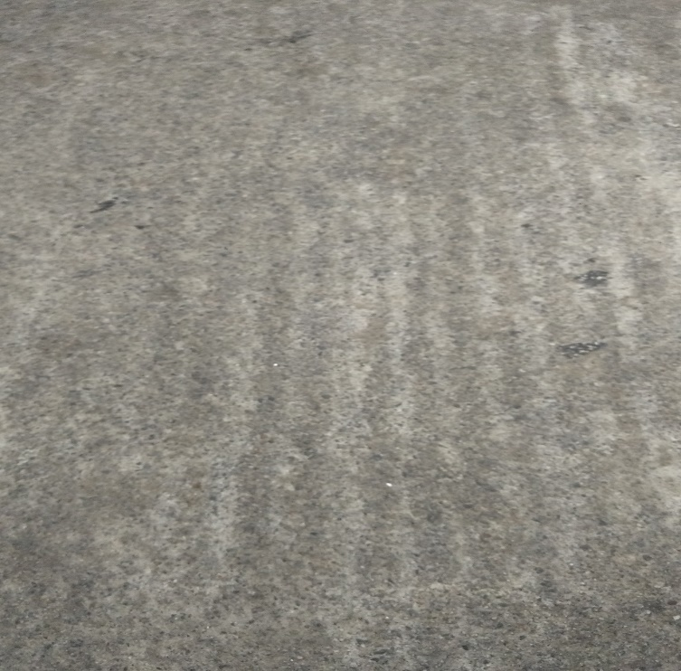
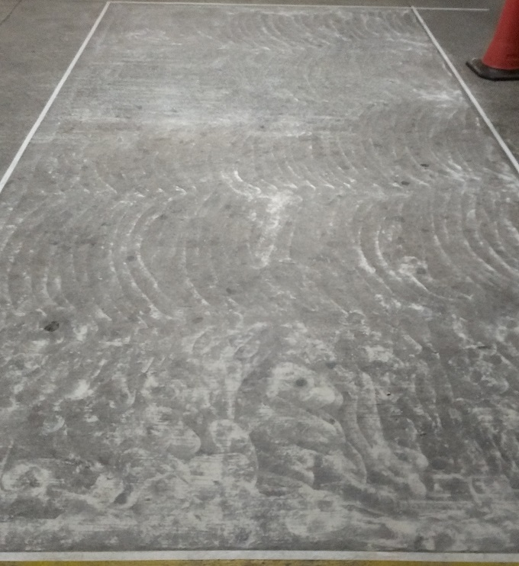
Application stages
11/07/26
Page <number>
ELANTAS Beck India Ltd.
Surface preparation
Existing Surface
Surface preparation – Grinding

Slide 8
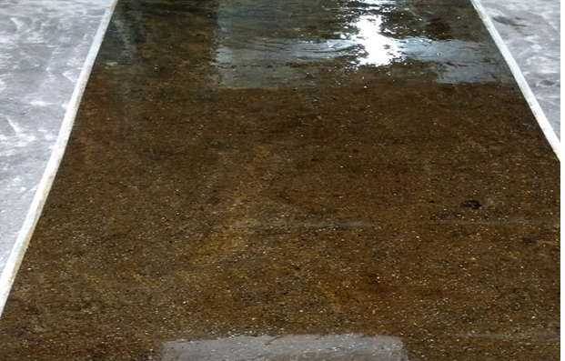
Application of Primer
11/07/26
Page <number>
ELANTAS Beck India Ltd.
Application Beck Bond 17 A + 17 B in ration 100 : 50 ,
Consumption as per BoQ or site condition.

Slide 9
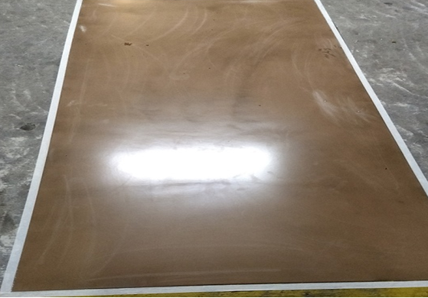
Application of screed , Epoxy screed
11/07/26
Page <number>
ELANTAS Beck India Ltd.
Application Dobe coat 5022 + EH 460 + Silica 100 in ration 100 : 100 : 400 ,
Consumption as per BoQ or site condition.

Slide 10
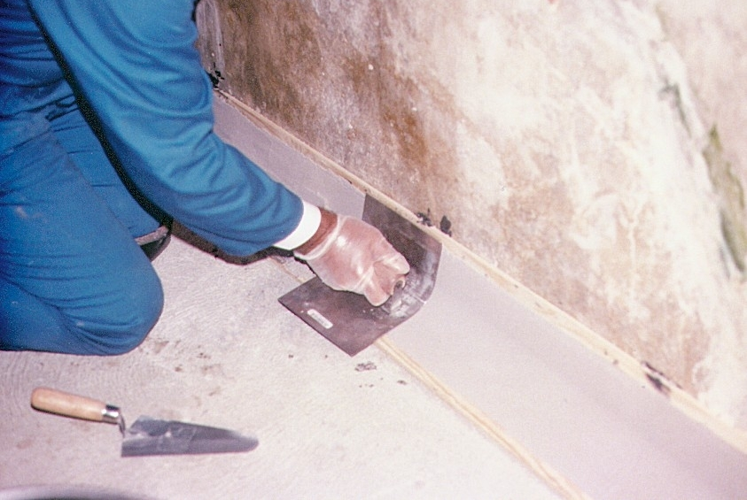
Application of Coving
11/07/26
Page <number>
ELANTAS Beck India Ltd.

Slide 11
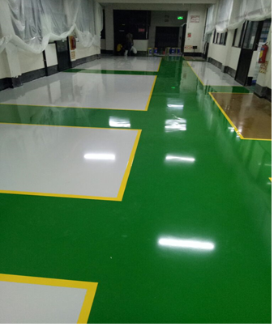
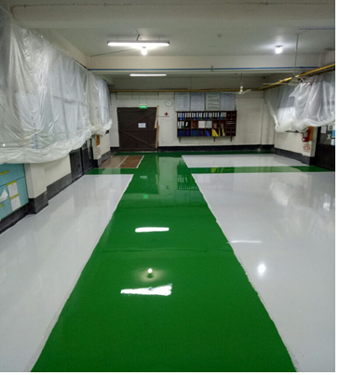
Application of Self leveling epoxy top coat
11/07/26
Page <number>
ELANTAS Beck India Ltd.
Application beck bond SLF 36 A + 36 B + S 200 + pigment ration 100 : 55 : 210 : 7 ,
Consumption as per BoQ or site condition.

Slide 12
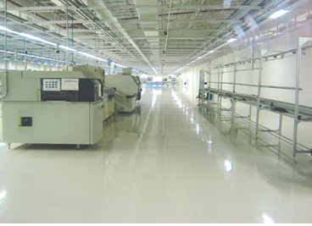

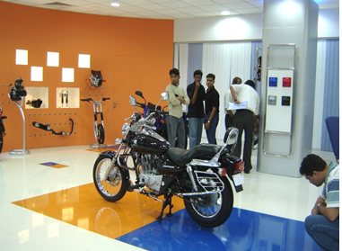
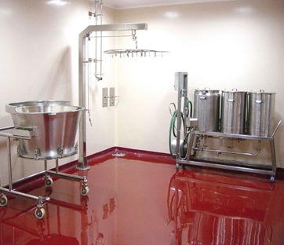
Total SLF 36 – epoxy system
11/07/26
Page <number>
ELANTAS Beck India Ltd.

Slide 13
Company Profile
11/07/26
Page <number>
ELANTAS Beck India Ltd.
BBCC for
Pharmaceutical Industry
August 2007
Elantas Beck India Ltd (formerly known as Dr. Beck) is a member of a German based group ALTANA.
ALTANA is a specialty chemical group with sales of more than EUR 2.2 Billion and 6200 employees worldwide.
In pursuit of ALTANA’s global commitment, ELANTAS Beck India Ltd develops new products & processes to meet changing customer needs.
In 2016, ELANTAS Beck India Ltd (EBIL) completed 60 years of operations in India.
The company manufactures wide range of electrical insulation and construction chemicals.
Construction chemicals products certified from CFTRI, ERDA, NCL, CPRI, CBRI, NTC and other accredited labs.

Slide 14
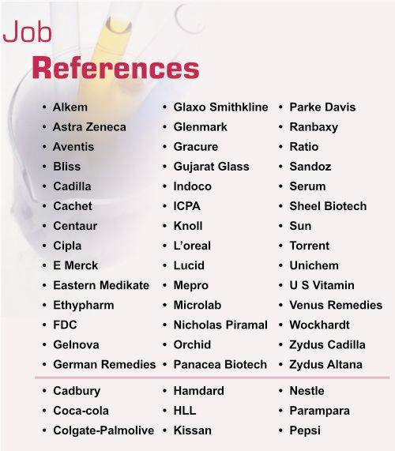
Major projects -
11/07/26
Page <number>
ELANTAS Beck India Ltd.
BBCC for
Pharmaceutical Industry
August 2007

Slide 15

Thank you for your attention

